Slide 1


Microsoft Intern
Engage
2022
PIYUSHA NAIR
MKSSS’s Cummins college of Engineering for women

Slide 2
Problem Statement
Data Analysis
Develop an application to demonstrate how the Automotive Industry could harness data to take informed decisions.
Demonstrate the use of data analytics in identifying:
Customer segments, Most popular car specification combination (engine type, fuel, mileage, etc.), Right time to launch a new car, etc.

Slide 3
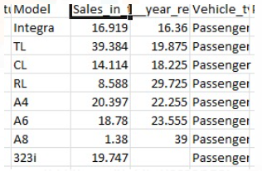
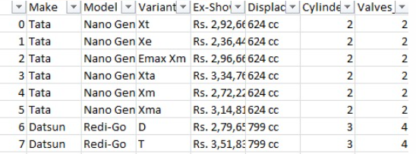



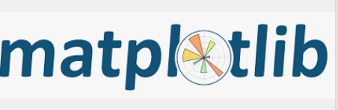
Dataset And Technical Stack
Dataset Used :
Automobile dataset (sample dataset provided)
This dataset includes car specifications and is taken from acehacker website.
2. Car sales dataset :
This dataset contains information about the sales of cars, their launch dates, etc. It has been from Kaggle website for predictions
Technical Stack
Python
Jupyter Notebook
Streamlit
Pandas
Matplotlib
Seaborn

Slide 4
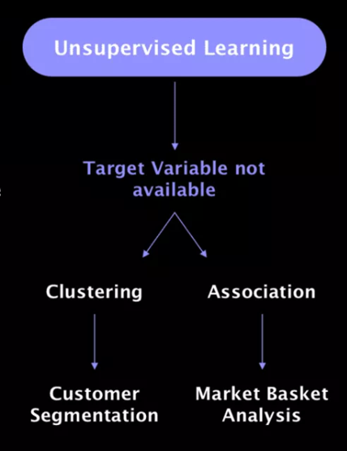
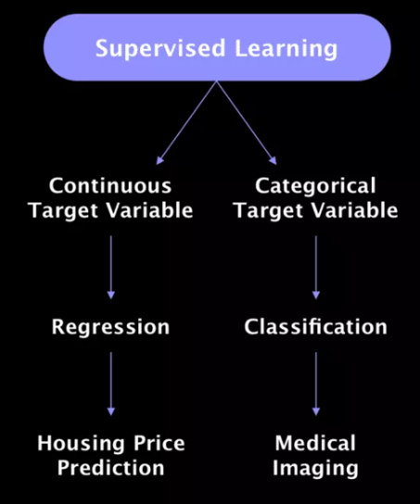
Solution - Machine Learning Algorithms
Unsupervised Learning
There are not predefined and known set of outcomes
Look for hidden patterns and relations in the data
Types :
clustering: group data according to "distance"
association: find frequent co-occurrences
link prediction: discover relationships in data
data reduction: project features to fewer features
Supervised Learning
For every example in the data there is always a predefined outcome
Models the relations between a set of descriptive features and a target (Fits data to a function)
Types
Regression – Predicts continuous (numerical) values.
Classification - Predicts which class (categorical) a given sample of data (sample of descriptive features) is part of (discrete value).

Slide 5
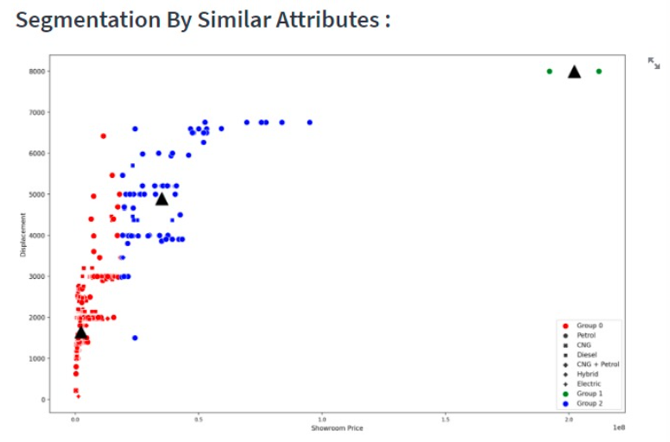
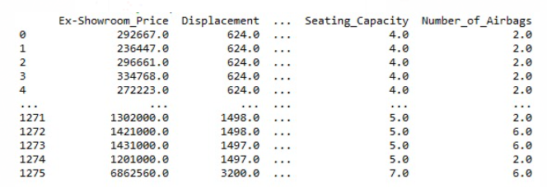
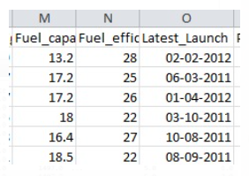

Segmentation and Launch Month Prediction
Unsupervised Learning
Used Clustering technique to categorize the Automobiles into 3 segments.
Supervised Learning
Used Classification to predict the best Launch month for new vehicles
Predicted Month for Launching : October

Slide 6
Implementation Details
Segmentation flow
Pre-processing
Dimensionality Reduction
Model Learning
Car specifications
Three Popular
Segments
Launch Month Prediction flow
Car specifications
Pre-processing
Dimensionality Reduction
Model Learning
Predict Launch Month for customer provided specs
2. Predict Launch Month for
popular segments
3. Sales prediction
+
Car sales

Slide 7
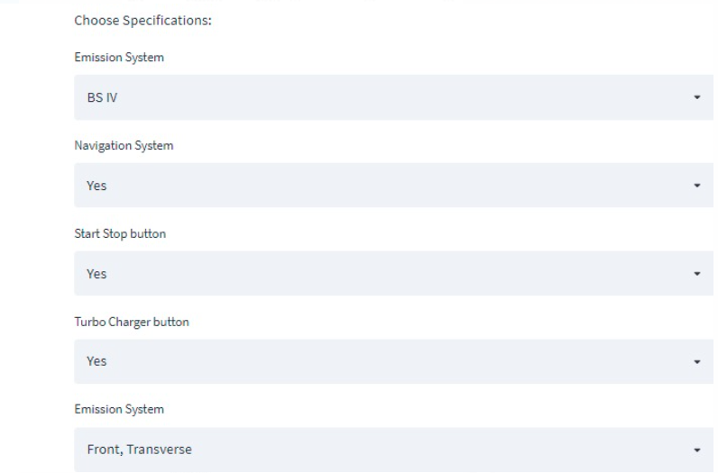
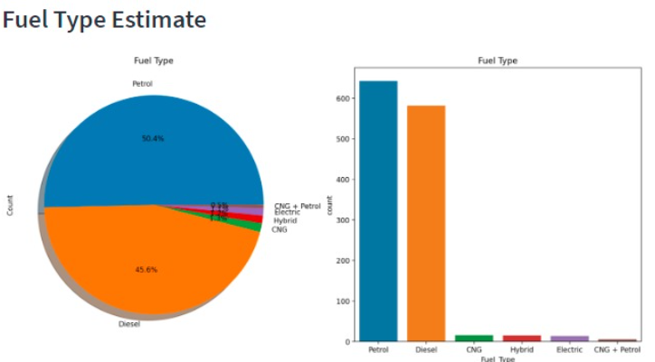
User Interface Features & Technical Stack
Streamlit :
Streamlit app turns data scripts into sharable web apps.
Interactive user web page
Colourful graphs and Plotting

Slide 8
Demo

Slide 9

Future Scope
The project can use front end technologies rather than a web app which can increase it’s time efficiency.
Project can include additional functionalities for every individual car company.
It can include a trend section which includes all the latest features people wish in their Dream Car

Slide 10
Thank you
PIYUSHA NAIR
MKSSS’s Cummins college of Engineering for women

